Slide 1
CAPSTONE PROJECT 3
Credit Card Default Prediction Supervised ML Classification Model
Team Members Anas Mustafa Chetan Rajput Sarthak Rastogi

Slide 2
Understanding the concept
What is credit card default?
Credit card default happens when you have become severely delinquent on your
credit card payments. Default is a serious credit card status that affects not only
your standing with that credit card issuer but also your credit standing in general
and your ability to get approved for other credit-based services.
Why Do we need to predict Credit card default beforehand ?
The financial institution can be capable of preventing the loss. Here, we have
used various machine learning classification techniques to carry out Default related analysis.

Slide 3
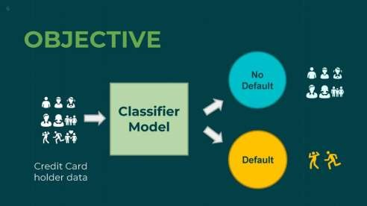
Content
Introduction
Defining Problem Statement
Data Summary
Approach Overview
EDA / Feature analysis
Modelling Overview
Model evaluation
Feature Importance
Challenges
Conclusion

Slide 4
Introduction
This dataset contains information on default payments, demographic factors, credit data, history of payment, and bill statements of credit card clients in Taiwan from April 2005 to September 2005.
This project is aimed at predicting the case of customers default payments in Taiwan. From the perspective of risk management, the result of predictive accuracy of the estimated probability of default will be more valuable than the binary result of classification - credible or not credible clients.

Slide 5

Overview and Objective
O ve r v iew
In today’s world credit cards have become a lifeline to a lot of people so banks provide us with credit cards. Now we know the most common issue there
is in providing these kind of deals are
Objective
The main objective of this project is aimed at
predicting the case of customers default
people not being able to pay the
These people are what we call
“Defaulters”.
bills.
payments in Taiwan. From the perspective of risk management, the result of predictive accuracy of the estimated probability of default will be more valuable than the binary result of classification - credible or not credible clients.

Slide 6
Data Summary
X1 - Amount of credit(includes individual as well as family credit)
X2 - Gender
X3 - Education
X4 - Marital Status
X5 – Age
X6 to X11 - History of past payments from April to September
X12 to X17 - Amount of bill statement from April to September
X18 to X23 - Amount of previous payment from April to September
Y - Default payment

Slide 7

Approach Overview
Data inspection and cleaning Exploring data, checking for outliers Clean data to get it ready for Analysis
EDA & Data Pre-processing Checking distributions of variable Univariate and multivariate analysis Checking for imbalanced dataset
Modelling
Logistic Regression Decision Tree Random Forest
XGBoost

Slide 8
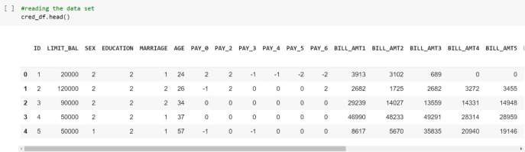
Basic Data Exploration
Taiwan from April 2005 to September 2005.
Dataset contains 30000 rows & 25 columns.
In dataset, 6 months payment and bill data available.
There are no null or duplicate values.

Slide 9
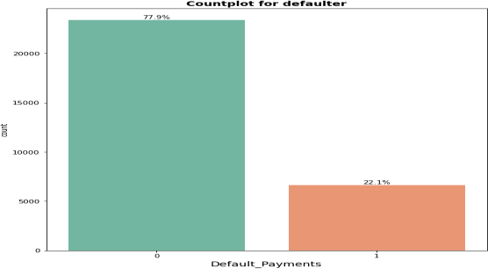
Exploratory Data Analysis
Looking at data, we will need to check if it is a case of Imbalanced dataset.
Count of Non-default is a lot higher than default value.
Non- Default data is 77.9% while Default cases are 22.1% as in dataset.

Slide 10
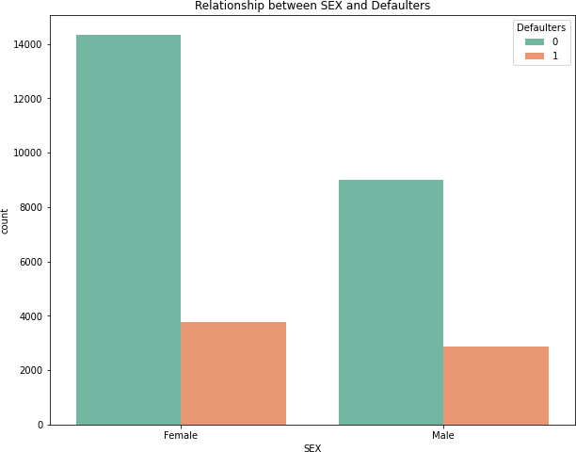
EDA- Gender Wise Defaulter Prediction
Number of Male credit holder is less than Female.
The ratio of defaulters is High in Male.

Slide 11
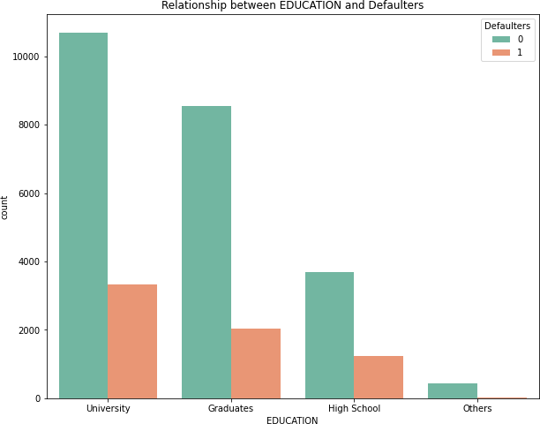
EDA - Education wise defaulter prediction
More number of credit holders are university students followed by Graduates and then High school students.
University students have higher default payment than graduates and high school people.
From university 11%are default, from graduate 7% are default, and from high school 4% are default.

Slide 12
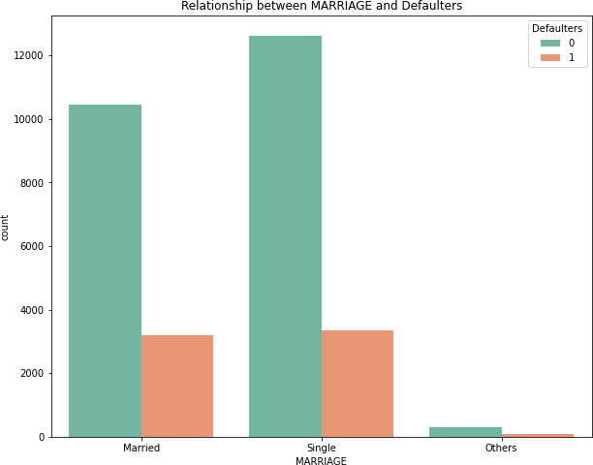
EDA – Marital status wise defaulter prediction
From graph, we can say that more number of credit cards holders are Single as compared to Married and others.
Here it seems that married are more
likely to default than single.
From single 11% are default and from married approx 11% are defaulter.

Slide 13
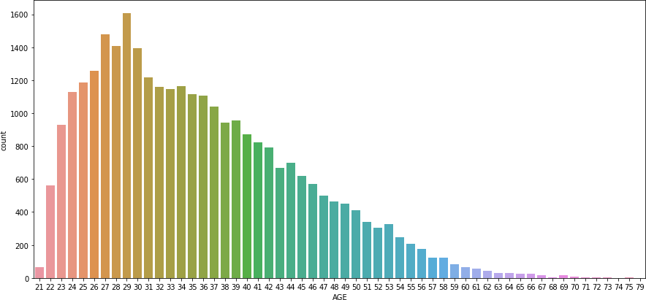
EDA– AGE wise Defaulter Prediction
More number of credit card holders age between 26-30.
Also more number of Defaulters are between 27-29 years.

Slide 14
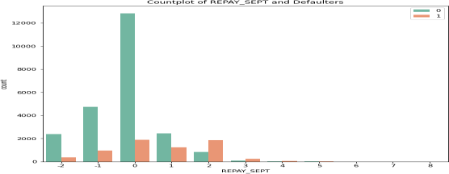
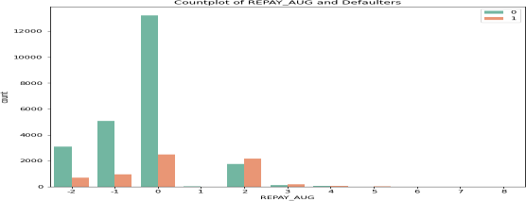
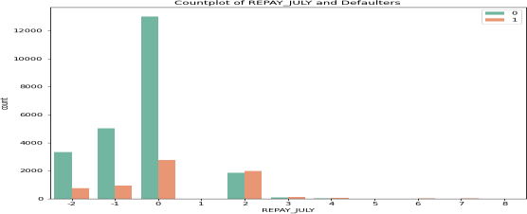
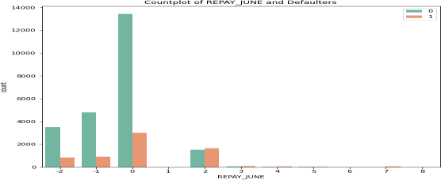
REPAYMENT STATUS

Slide 15
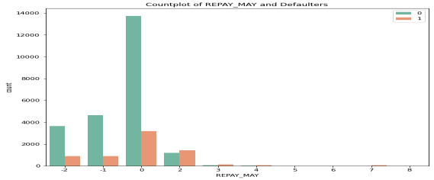
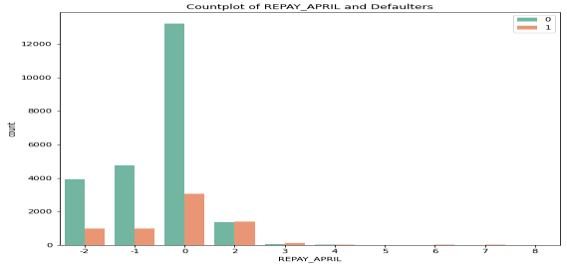
REPAYMENT STATUS
Repayment of different
months.
Blue – Non Defaulters
Pink – Defaulter
2 = No consumption
1 = paid in full
0 = use of revolving credit (paid minimum
only)
1 = payment delay for one month
2 – 8 (for consecutive months).
After careful observation we found that most credit card payment did by the customer on time. we see the distribution of the plot peak at 0 value ,which means on the x scale no delay in the payment of card

Slide 16
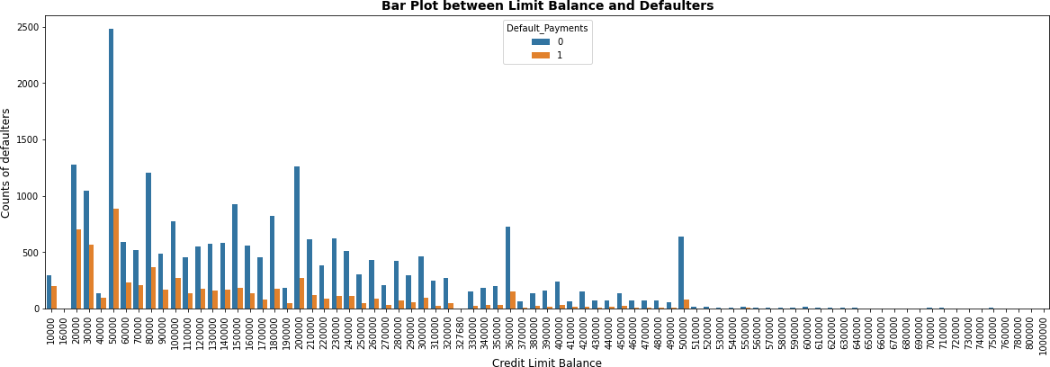
LIMIT BALANCE
Majority of defaulters are those who have credit limit between 20k to 300k.
After Credit limit 500k, numbers of defaulters are almost negligible.

Slide 17
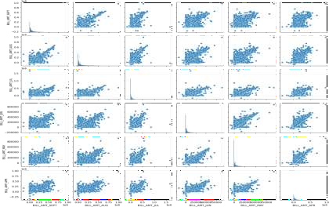
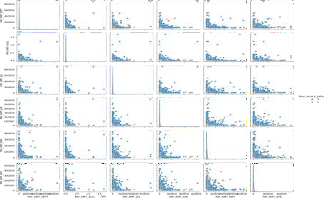
PAIR PLOTS
PAIR PLOT OF PAY
PAIR PLOT OF BILL
The 1st pair plot shows the distribution of bill amount statements for each month
explicitly for defaulters and non-defaulters.
The 2nd pair plot shows the distribution of payment statements for each month
explicitly for defaulters and non-defaulters

Slide 18
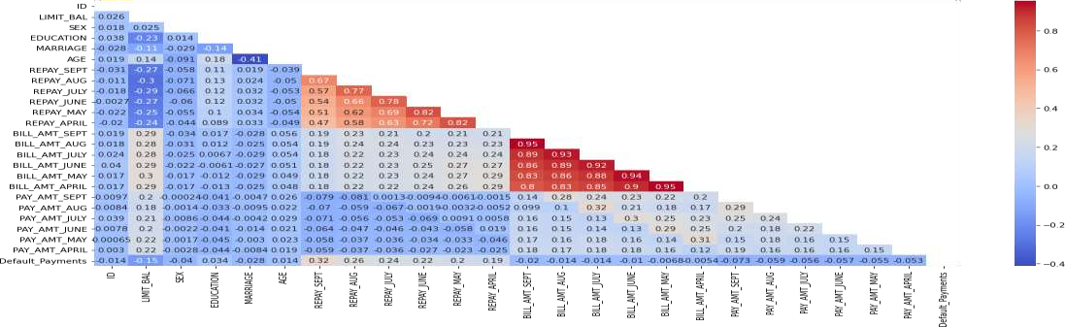
Correlation between parameters
We can see that no correlation between the features so there is no need to remove or
drop some features.

Slide 19
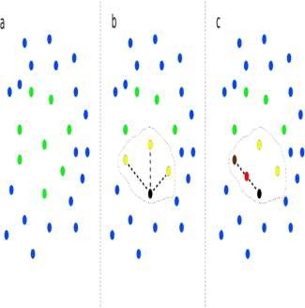
SMOTE(Synthetic Minority Oversampling Technique)
Our dataset is imbalanced which can lead to Biasness While Building Model.
For Balancing We Use SMOTE. SMOTE is an algorithm that performs data augmentation by creating synthetic data points based on the original data points.
The advantage of SMOTE is that you are not generating duplicates, but rather creating synthetic data points that are slightly different from the original data points.

Slide 20


Modeling Overview
This is Classification problem statement.
There is Imbalance data with 78% non-defaulters and 22% defaulters.
We have applied following models :
Logistic Regression
Decision Tree
Random Forest
XGBoost
Default or Not_defa ult

Slide 21
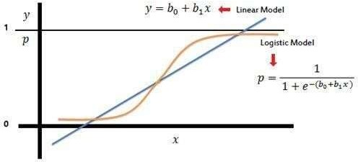
Logistic Modelling
LO G I S T I C R E G R E S S I O N
Logistic Regression is a Machine Learning algorithm and is basically used for binary classifications like yes-no, true-false, male-Female, etc.
It take the linear combination and apply a sigmoid function (logit). The Sigmoid curve gives value between 0 & 1.
Best Parameters {'C': 0.2, 'penalty': 'l2'}

Slide 22
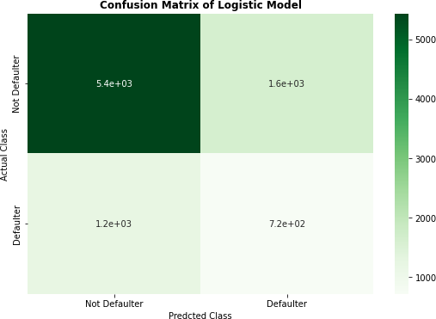
Confusion Matrix of Logistic Model
Precision score of logistic model: 0.3064
Recall score of logistic model:
0.3701
F1 score of logistic model:
0.3352
ROC AUC score of logistic model:
0.5699

Slide 23
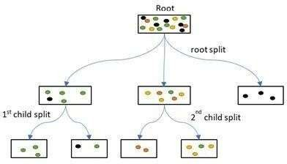
Decision Tree
D E C I S I O N TRE E C L A S S I F I E R
It is a graphical representation for getting all the possible solutions to a problem/decision based on given conditions.
The objective of Decision tree algorithm is to find the relationship between the target column and the independent variables and Express it as a tree structure.
Best parameters : {'max_depth': 2, 'min_samples_leaf': 2, 'min_samples_split': 2}

Slide 24
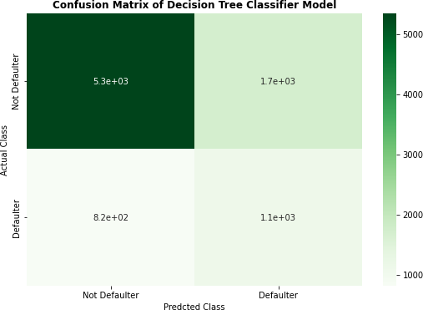
Confusion Matrix of Decision tree Classifier
Recall score of
Decision Tree Classifier: 0.5773
Precision score of Decision Tree
Classifier: 0.5773
F1 score of Decision Tree Classifier:
0.4691
6 ROC-AUC score of Decision Tree
Classifier: 0.667200

Slide 25
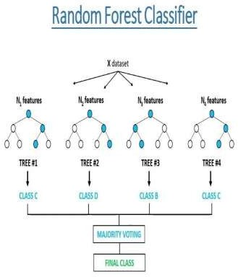
RANDOM FOREST CLASSIFIER
Random Forest Classifier
The random forest is a classification algorithm consisting of many decisions trees. It uses bagging and feature randomness when building each individual tree to try to create an uncorrelated forest of trees whose prediction by committee is more accurate than that of any individual tree.

Slide 26
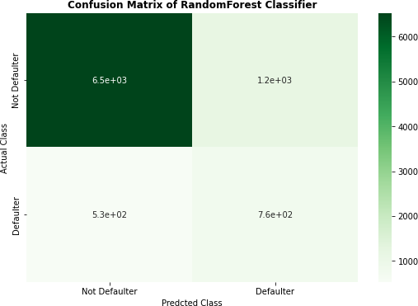
Confusion Matrix of Random Forest Classifier:-
Precision Score of Random Forest with
Hyperparameter Tuning: 0.39381
Recall Score of Random Forest with
Hyperparameter Tuning: 0.59087
F1 Score of Random Forest with
Hyperparameter Tuning: 0.47262
ROC AUC Score of Random Forest with
Hyperparameter Tuning: 0.71914

Slide 27
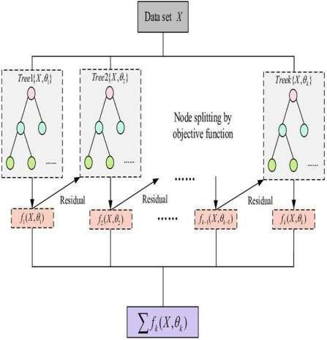
XGBOOST CLASSIFIER
XG B O O S T C L A S S I F I E R
Stands for:– Extreme Gradient Boosting.
XGBoost is a powerful iterative learning
algorithm based on gradient boosting.
Regularization to avoid over fitting
Tree pruning using depth-first approach
It is generally used for very large dataset

Slide 28
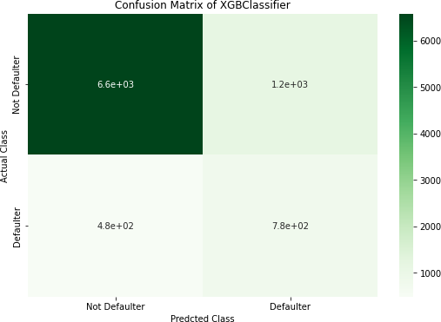
Confusion Matrix of XG Boost Classifier
Precision Score of Random Forest with Hyperparameter Tuning: 0.400515
Recall Score of Random Forest with
Hyperparameter Tuning: 0.617647
F1 Score of Random Forest with
Hyperparameter Tuning: 0.485928
ROC AUC Score of Random Forest with Hyperparameter Tuning: 0.7337137

Slide 29
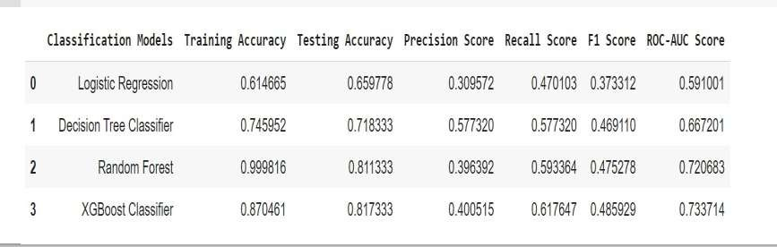
MODEL EVALUTION

Slide 30
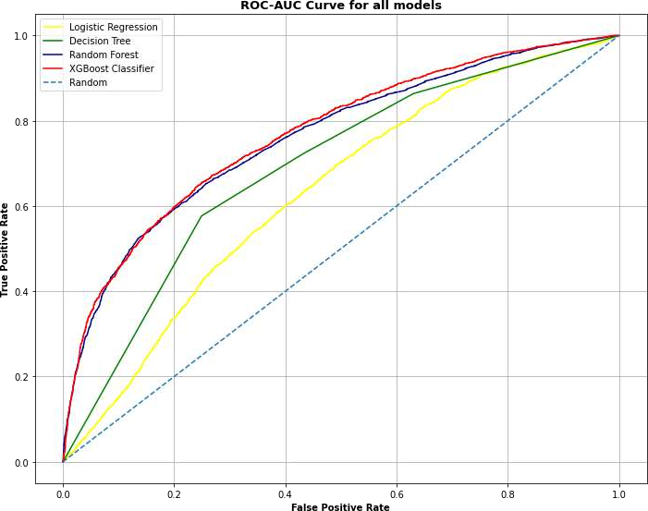
ROC CURVE
Receiver Operating Characteristic (ROC) summarizes the model’s performance by evaluating the trade offs between true positive rate (sensitivity) and false positive rate(1- specificity). For plotting ROC, it is advisable to assume p > 0.5 since we are more concerned about success rate.

Slide 31

Challenges
Reading the dataset and understanding the problem statement.
Designing multiple visualizations to summarize the Data points in the
dataset and effectively communicating the results and insights to the reader.
Dealing with Imbalanced Dataset
Feature engineering
Feature selection - Making sure we don’t miss any important feature.
Careful tuning of hyperparameters as it affects accuracy.
Computation time was a big challenge for us.

Slide 32
Conclusion
Distribution of defaulter vs. non defaulter - around 78% are non defaulter and 22% are defaulter. Also we check for Marriage, Education, Sex with respect to defaulter and we found in marriage more number of defaulter are Male, in Education more no. of defaulter are University Students & in Marriage more no. of defaulter are Married.
After that we build the Four models Logistic Regression, Decision Tree, Default
XGBoost Classifier & Random Forest . The best accuracy is obtained from the Default XGBoost Classifier
Using a Logistic Regression classifier, we can predict with 65.97% accuracy, whether
a customer is likely to default next month.

Slide 33
5. With Decision Tree classifier having precision 57.77%, we can predict with accuracy of
71.83%, whether customer is likely to default next month.
Using Random Forest, we can predict with accuracy of 81.13%, whether customer will
be defaulter in next month.
XG Boost Classifier with recall 61.77%, accuracy of 81.73%, we can predict whether
customer is likely to default next month.
From the models that are applied on the dataset, XG Boost and Random Forest are giving
the best evaluation matrices (precision, F1-score and ROC-AUC score).
On behalf of these matrices we can predict whether customers would be defaulter or
not in the next month.
From the ROC-AUC curve, Random Forest and XG Boost classifier are more able to
distinguish between positive and negative class.

Slide 34
T H A N K YOU!!

